Slide 1
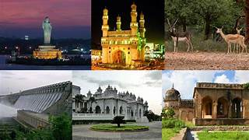

Telangana growth analysis codebasics resume project challenge #7
Analysis report by:
Kamutam Litheeshwar​

Slide 2
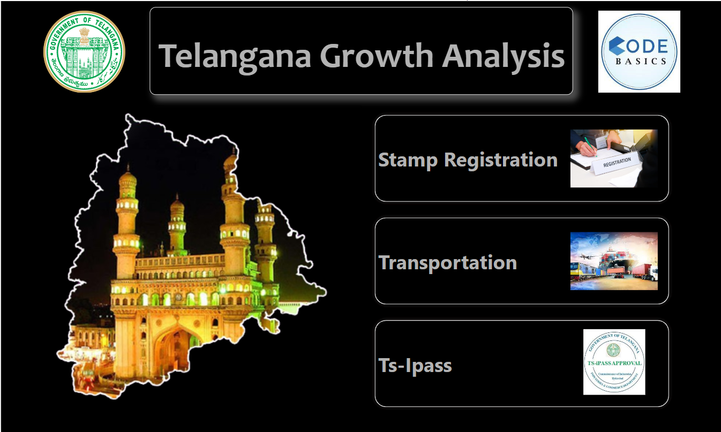

Slide 3
AGENDA
Introduction​
Objectivies
​Primary Insights
Secondary Insights
​Recommendations

Slide 4
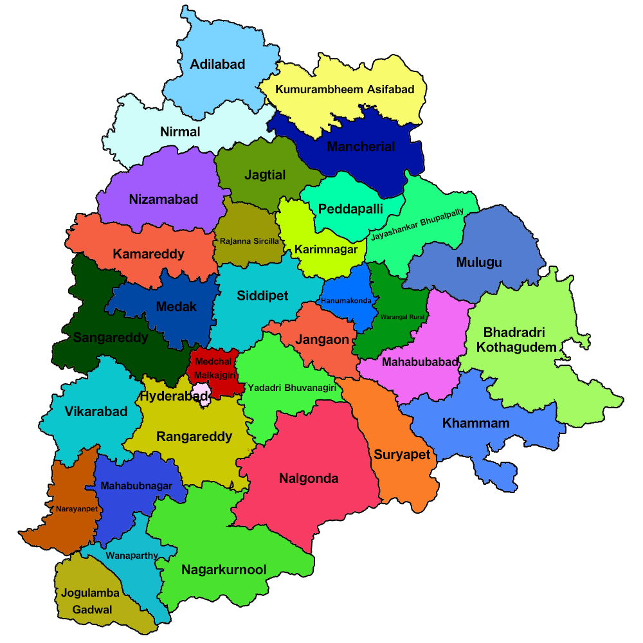
INTRODUCTION
Telangana is the 29th state of the india, formed on the 2nd of June 2014. It has 33 districts.Telangana launched its Open Data Policy in September 2016, with a view to bring in transparency, accountability, responsiveness and efficiency in governance, and earned the distinction of only the second State in India to do so. Through the available data from open data it helps to drag a beautiful insights a which made a part to become the state growth.

Slide 5
OBJECTIVES
>> Explore Stamp Registration, Transportation and Ts-Ipass Datasets.
Understand their attributes, categories and time period.
>> Analyze trends and patterns within each department.
>> Identify growth opportunities and areas needing attention.
>> Find correlation among these departments and report the overall
growth of the state through insights and relevant visuals such as
shape maps.

Slide 6
PRIMARY INSIGHTS
Growth Analysis :
→Stamp registrations.
→Transportation
→Ts-Ipass

Slide 7
STAMP REGISTARTIONS

Slide 8
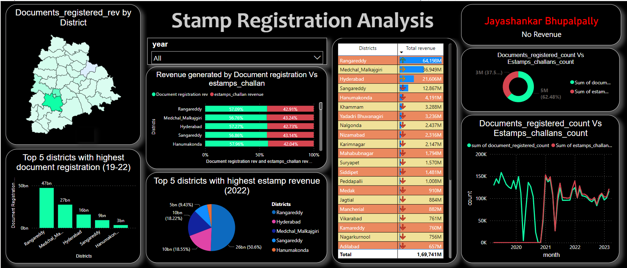
QUARTERLY PERFORMANCE

Slide 9
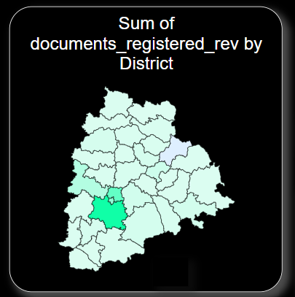
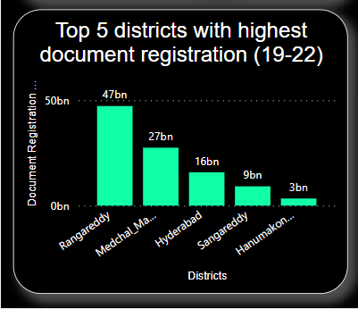
As we observe the above two visuals the highest document registrations is from the district of rangareddy with approximetly 108 millions
There was no revenue generated from the district “Jayashankar Bhupalpally”
Rangareddy,Medhchal,Hyderabad,Sangareddy,Hanumakonda are the top districts that generates revenue more than 3billions b/w 2019 – 2022.

Slide 10
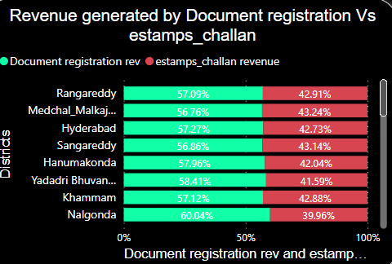
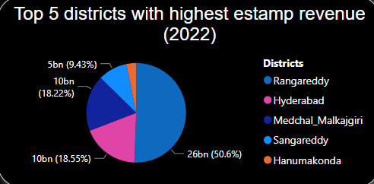
For every districts the document registration revenue is more because the Estamp challans has been implemented late in Telangana .
After it’s implementstion in the fiscal year 2021 there is some flucuation in the document registration revenue

Slide 11
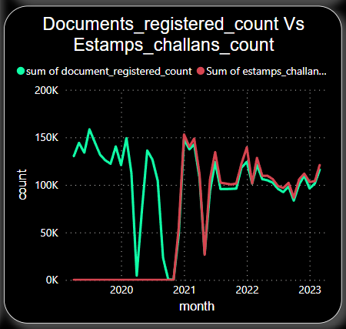
3. is there any alteration of e-stamp challan count and document registration count pattern since the implementation of e-stamp challan? If so, what suggestions would you propose to the government?
The document registrations gradually decreases as the Estamps challans started implemented
In the fiscal year 2020 the Estamp challans were not implemented in the Telangana.
But when it get implemented the document registrations were a bit lower than the estamp challans.

Slide 12
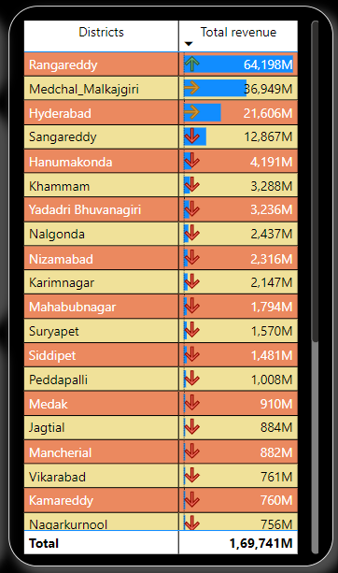
All the districts are categorized into three classes based on the amount generated during FY 2021 to 2022
Rangareddy generates more revenue followed by Medchal_malkajgiri and Hyderabad
Apart of theses three districts all the districts generates revenue less than 20 millions excluding Jayashankar Bhupalpally
Reasons:
Rangareddy,medchal and hyderabad are populated states so more population leads to generate more stamps revenue.

Slide 13
TRANSPORTATION ANALYSIS

Slide 14
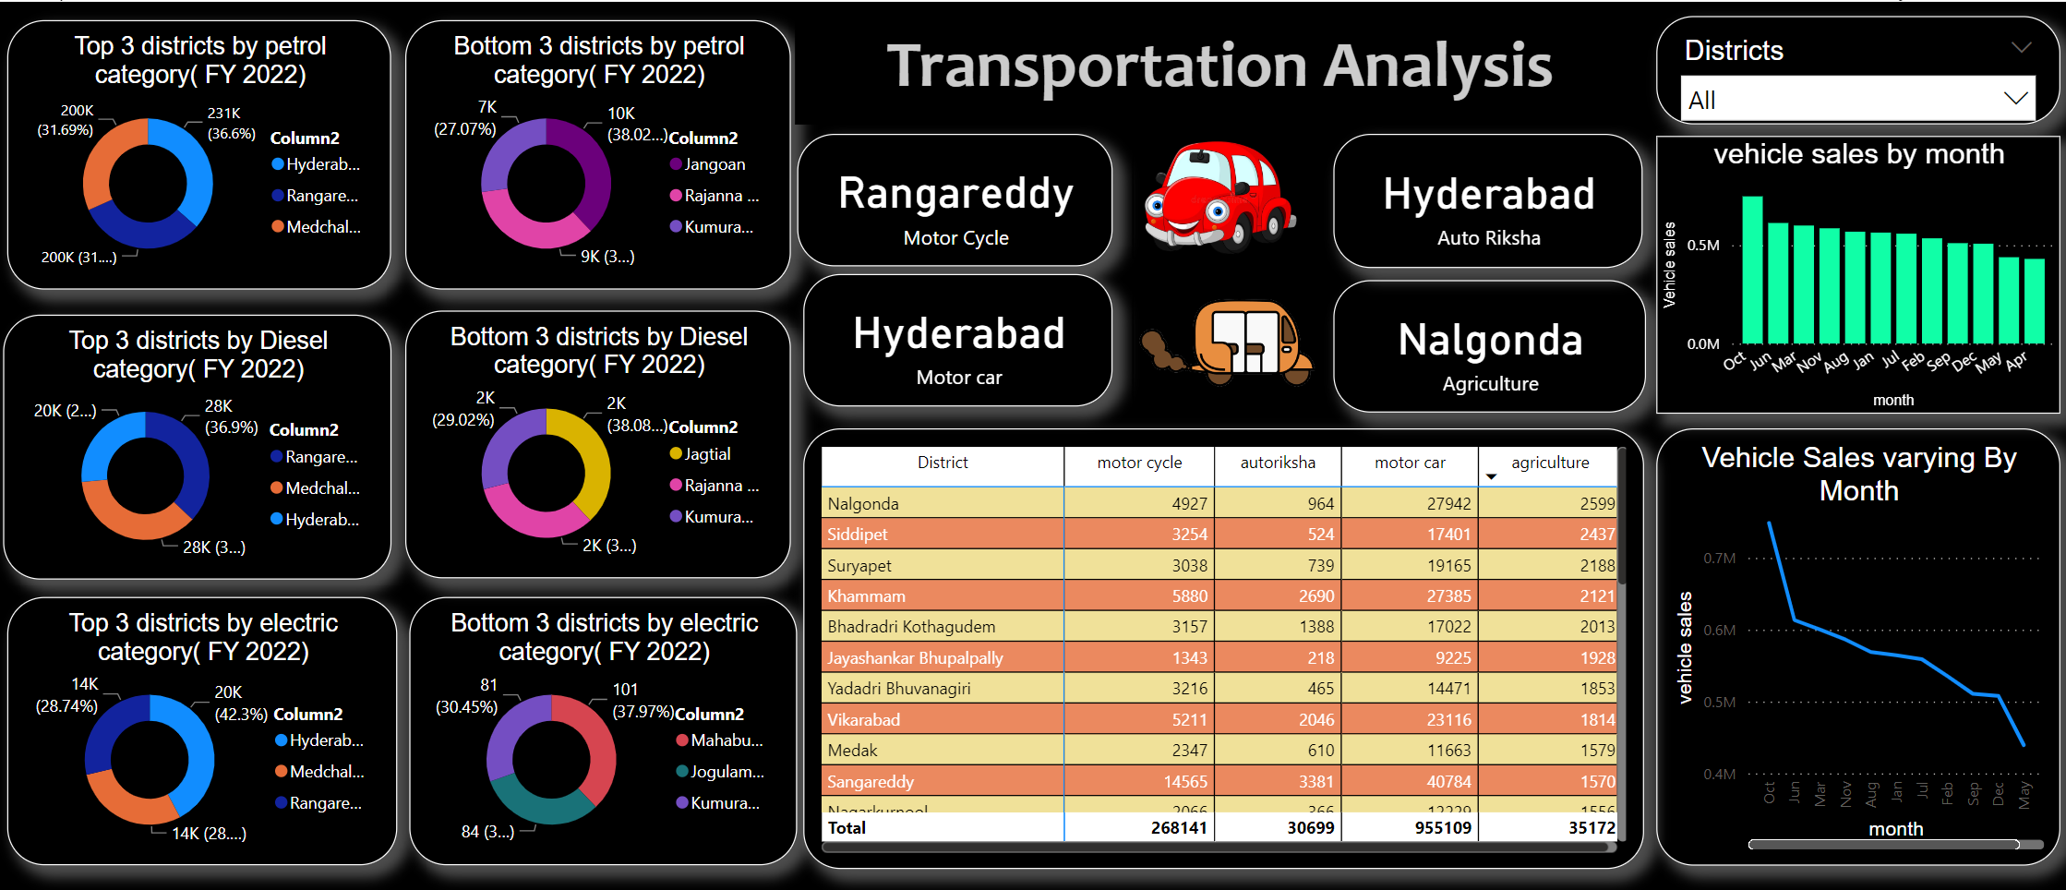
QUARTERLY PERFORMANCE

Slide 15
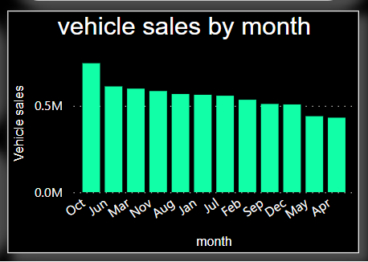
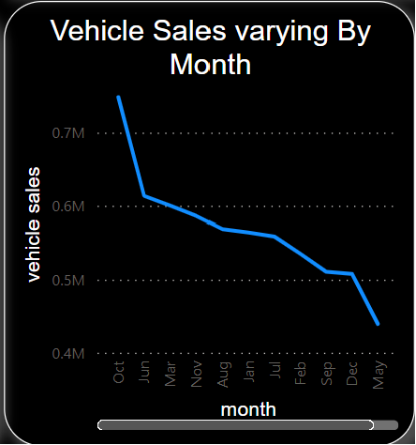
October is a good time to buy a vehicles because showrooms and manufacturing companies are clearing out stock of outgoing models. This period also coincides with many festivals.
Most probably other months like march,June ,July,novermber shows more trends in vehicle sales the factors may include are : economic factors, income , offers …etc

Slide 16
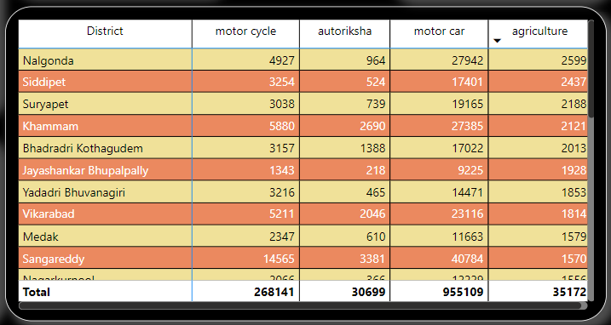
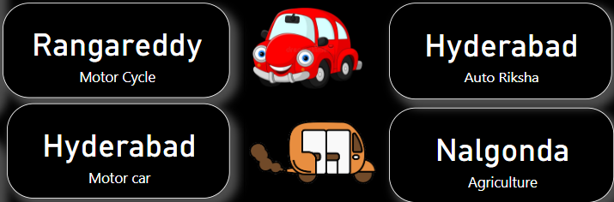
Agriculture related vehicles sold more in “Nalagonda” district because these districts is rich in agricultural lands and minerals
Mototr cars and Autoriksha are sold in hyderabd district where as motorcycles in Rangareddy district

Slide 17
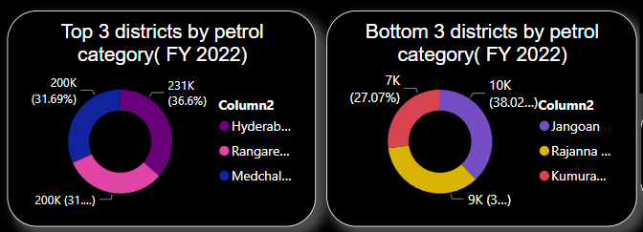
Category : Petrol Type

Slide 18
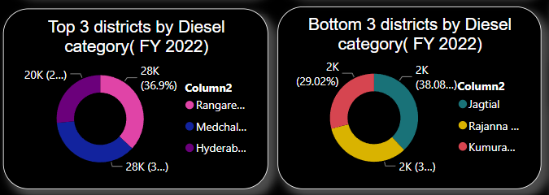
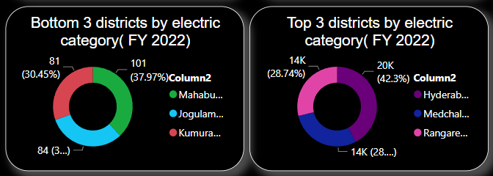
Category : Diesel Type
Category : Electric Type

Slide 19
TS-IPASS ANALYSIS

Slide 20
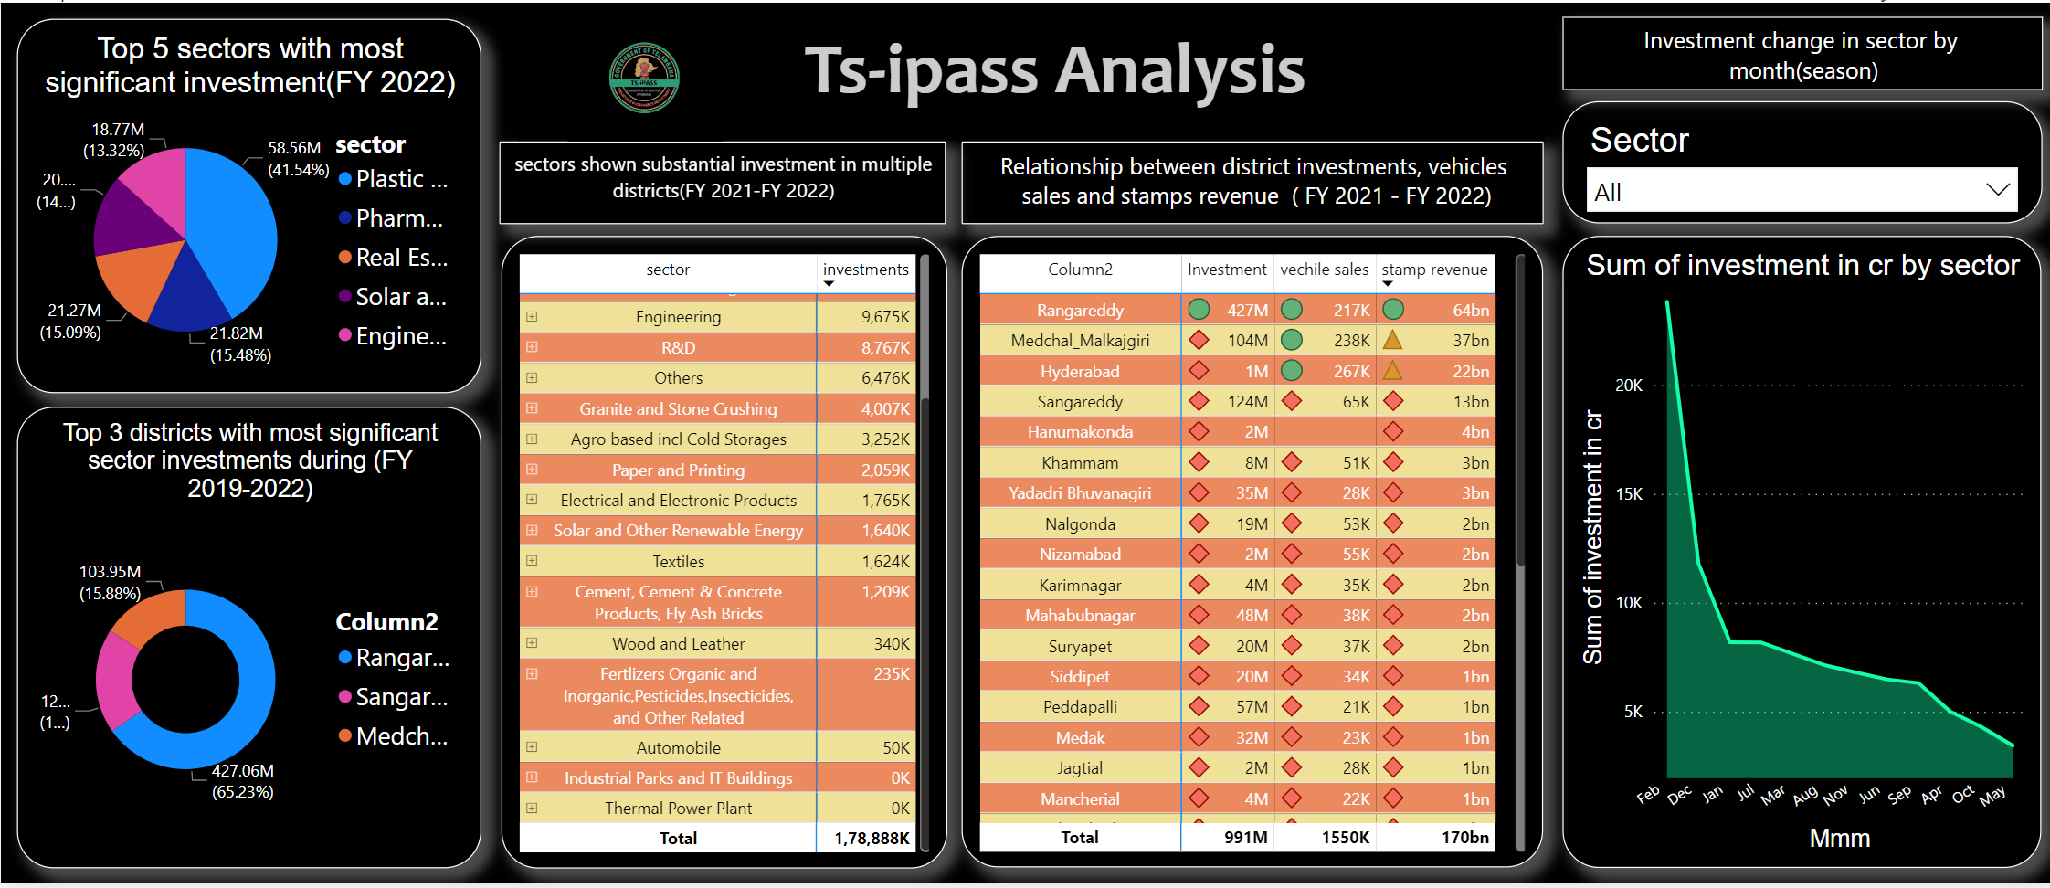
QUARTERLY PERFORMANCE

Slide 21
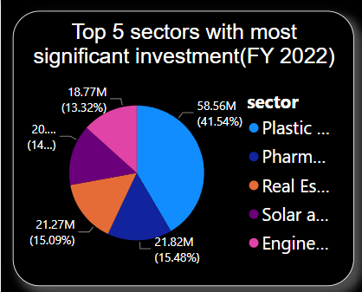
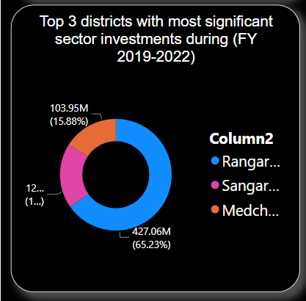
These 5 sectors plays a major role in the state economy growth. plastic and rubber industries are invested more because the need of plastic are incresed lot now a days.
9. List down the top 3 districts that have attracted the most significant sector investments during FY 2019 to 2022? What factors could have led to the substantial investments in these particular districts?
FACTORS:
Near to the Hyderabad(capital city)
Avilability of workers and resources
Industrial areas
Highly populated and more product demand

Slide 22
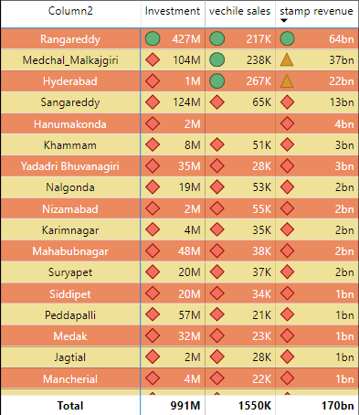
As we see the districts with more and moderate revenue has more vehicle sales
But the investment is only high for the district for which the stamp revenue is more and there no much relationship between these departments

Slide 23
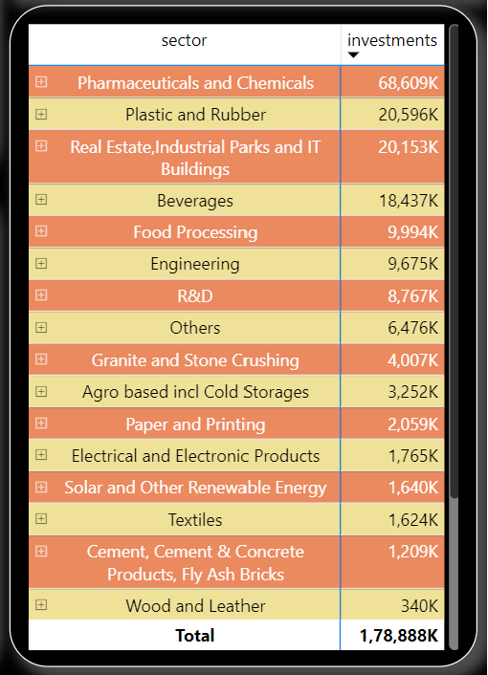
As will drill down on particular sector it shows the investment of a district in different districts.
Excluding Industrial parks and it buildings, Thermal plant all other sectors invested in multiple districts between 2021 and 2022.
The sectors like Engineering, Plastic and rubber ,Solar and other renewable energy, pharmaceuticals and chemicals , R&D shows the substantial investments between 2021 and 2022

Slide 24
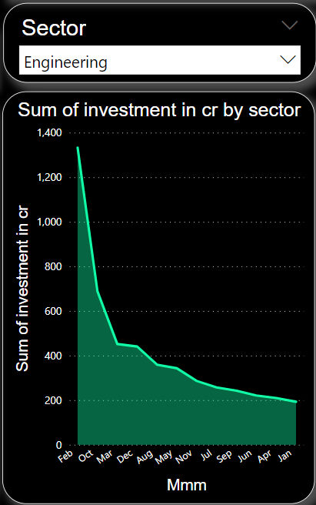
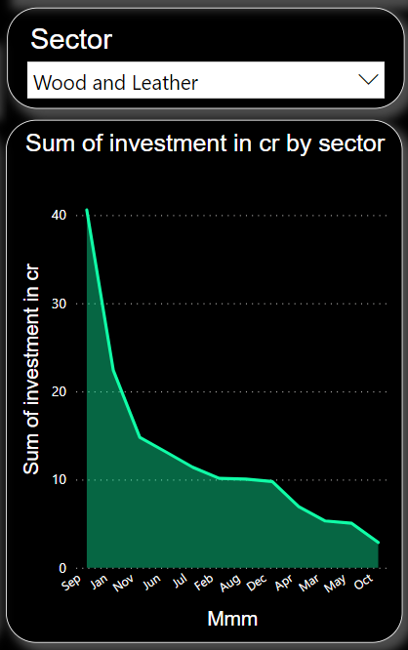
The investment of sectors changes by month. The investment is not same for sectors on all months

Slide 25
SECONDARY INSIGHTS

Slide 26
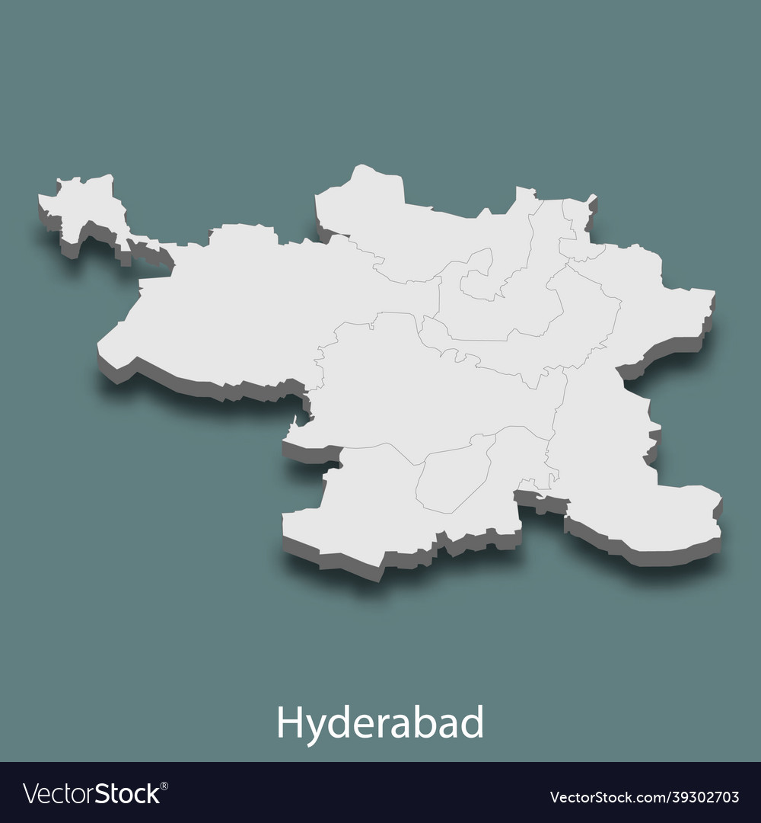
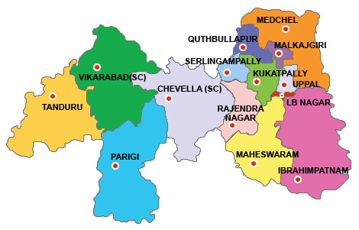
Hyderabad:
Hyderabad, the state capital, has traditionally been the most attractive destination for commercial real estate investment due to its robust economy, IT industry, and various business opportunities.
Rangareddy:
This district encompasses areas around Hyderabad and includes locations like Gachibowli, Madhapur, and Shamshabad, which have witnessed significant commercial development.

Slide 27
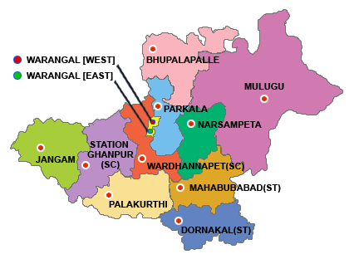
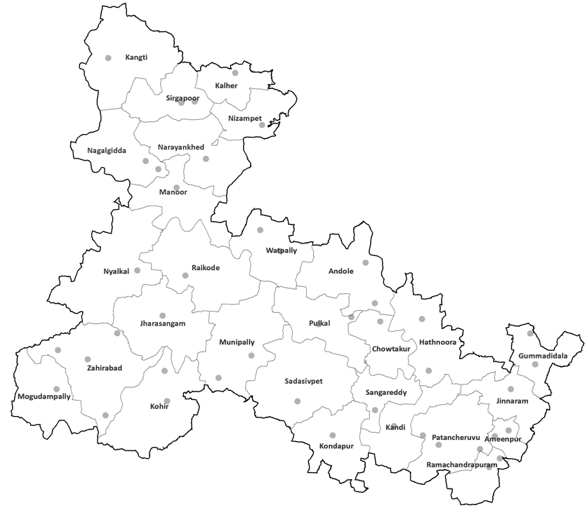
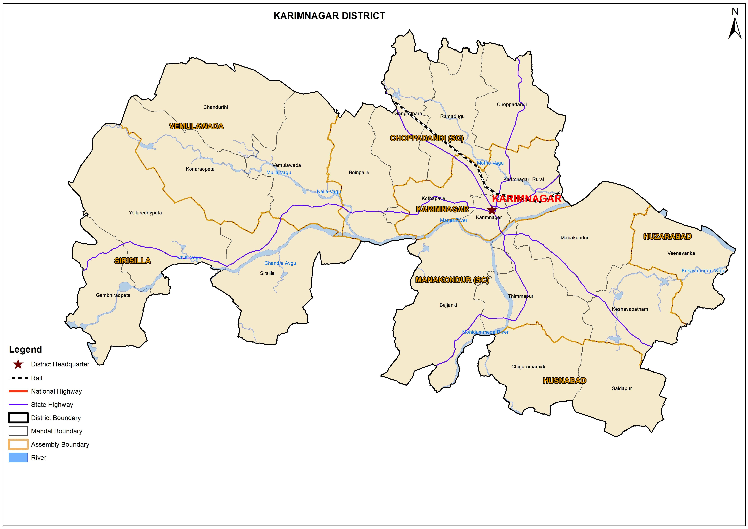
Warangal:
Warangal has been emerging as a potential commercial real estate destination, with a growing industrial base and improving connectivity.
Sangareddy:
Sangareddy is another district that has seen development in recent years, particularly in terms of industrial and infrastructure growth. Its proximity to Hyderabad and ongoing developments make it an area to watch for potential commercial property investments
Karimnagar:
Karimnagar was also showing promise for commercial property investment, driven by economic growth and improved infrastructure.

Slide 28
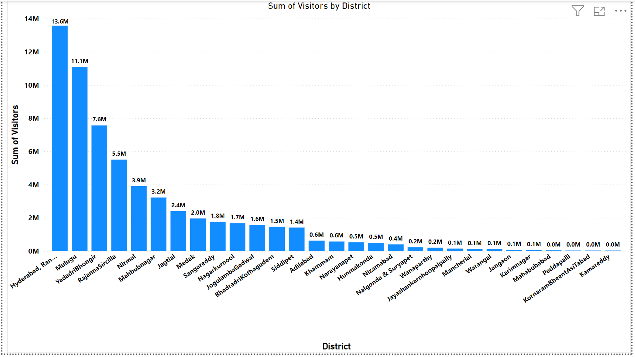
Economic Growth:
Tourism Promotion:
Invest in tourism infrastructure and promote cultural, historical, and natural attractions to attract tourists and generate revenue.

Slide 29
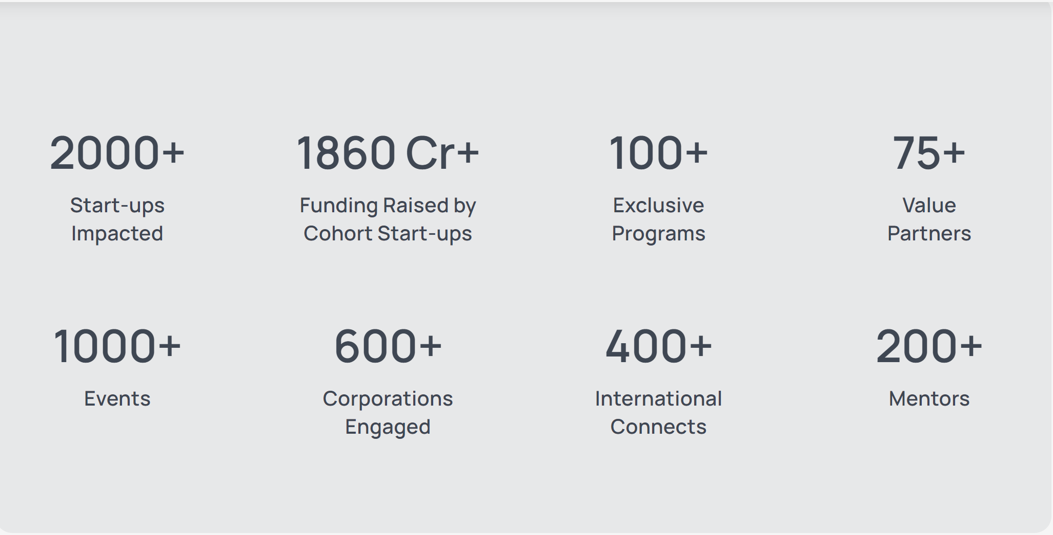
Employment:
IT and Innovation Hub:
Hyderabad, the capital of Telangana, has been a focal point for IT companies. The government continued to support the growth of the IT sector by providing infrastructure and facilities. Initiatives like T-Hub, an innovation hub for startups, have also been launched to foster entrepreneurship.

Slide 30
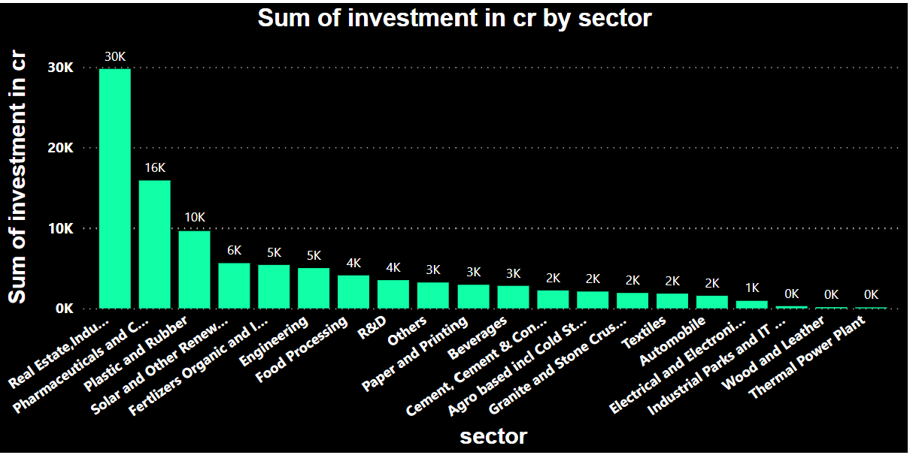
Investments:
Industrial and Investment Promotion:
The Telangana government has actively promoted industrial growth through its industrial policy. It offered incentives and subsidies to attract investments in various sectors, including information technology, pharmaceuticals, textiles, and manufacturing. The Telangana State Industrial Project Approval and Self-Certification System (TS-iPASS) was launched to streamline approvals for industries, making it easier for businesses to set up operations.

Slide 31
TOP 5 INSIGHTS AND RECOMMENDATION

Slide 32
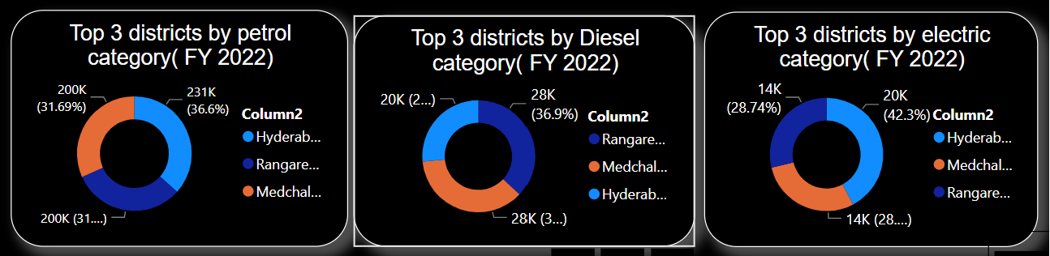
Hyderabad , Medchal-malkajgiri , Rangareddy are the top 3 districts in vehicle sales as they are most populated districts in the state
More sales of vehicles of different types is in the month of October The reason may the manufacturing companies clears all it’s stock and generates new productivity.

Slide 33
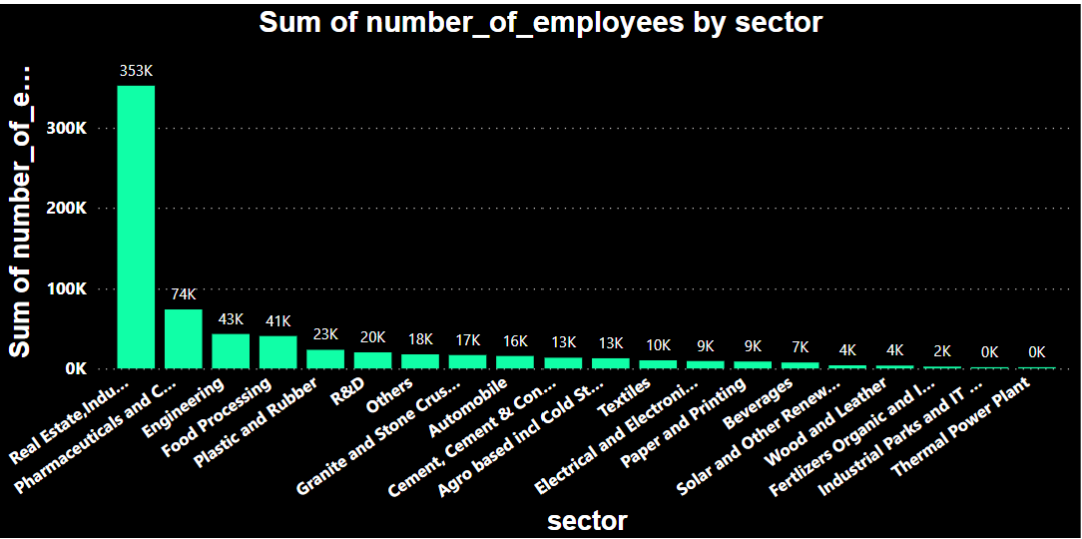
The revenue to the government is generated more from stamp registrations than vehicle sales and industrial investments . The revenue units of stamp registration is in billions where as the revenue from vehicle sales and industrial investments are in millions and thousands.
The richest district “Rangareddy” which contributed more revenue from stamp registrations and also hike in vehicle sales (motor cycles), also in industrial investments.
Real Estates, Industrial parks , IT sectors are high in investments and provides more employment in the state

Slide 34
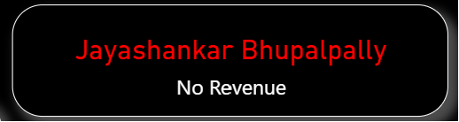
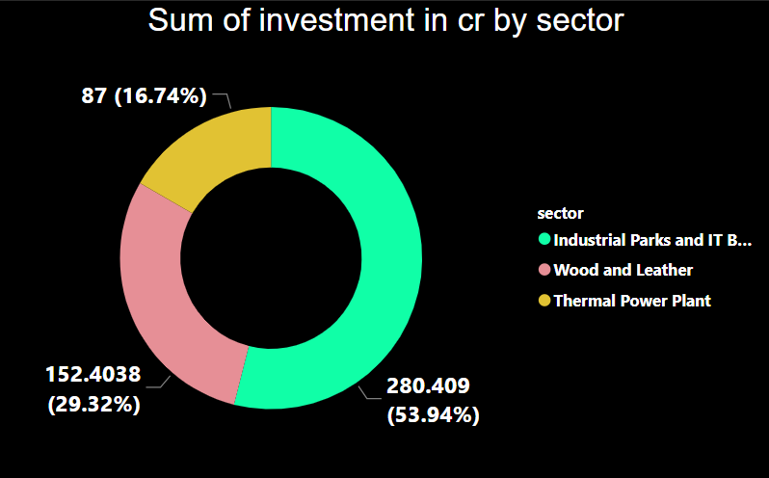
No revenue contributed from Jayashankar Bhupalpally The property rates and values need to be increase to generate document registration revenue from this district.
The investments in the sectors like industrial parks and it buildings, wood and leather, Thermal power plant are low compared to other sectors in the state.

Slide 35
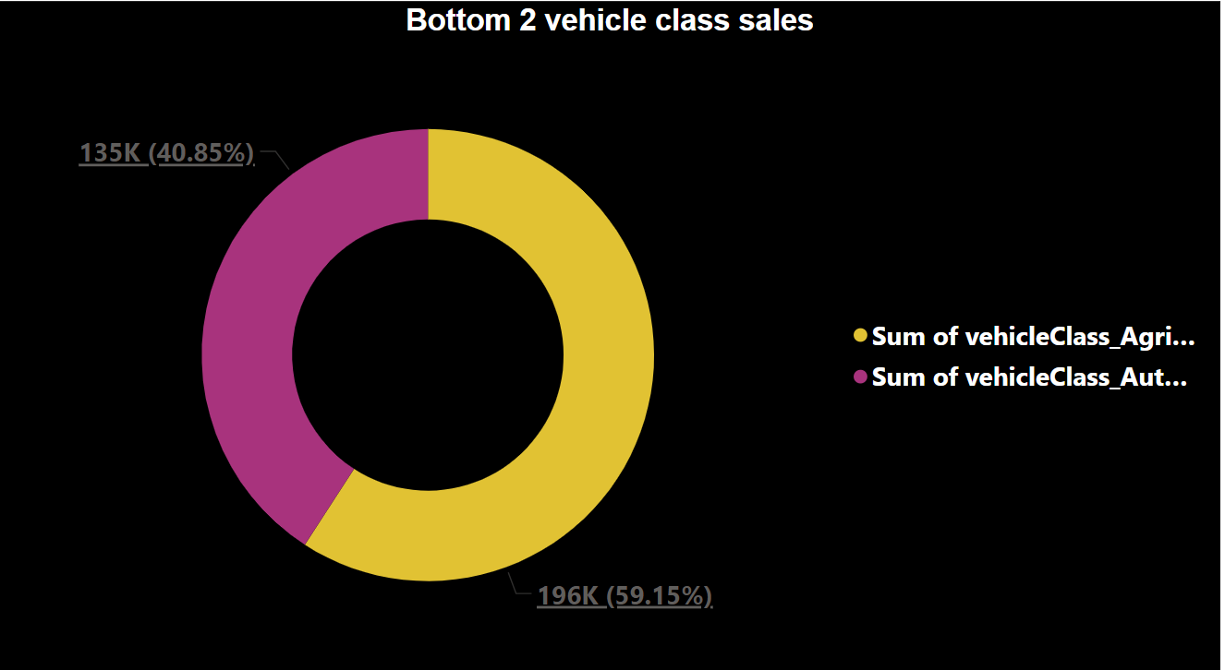
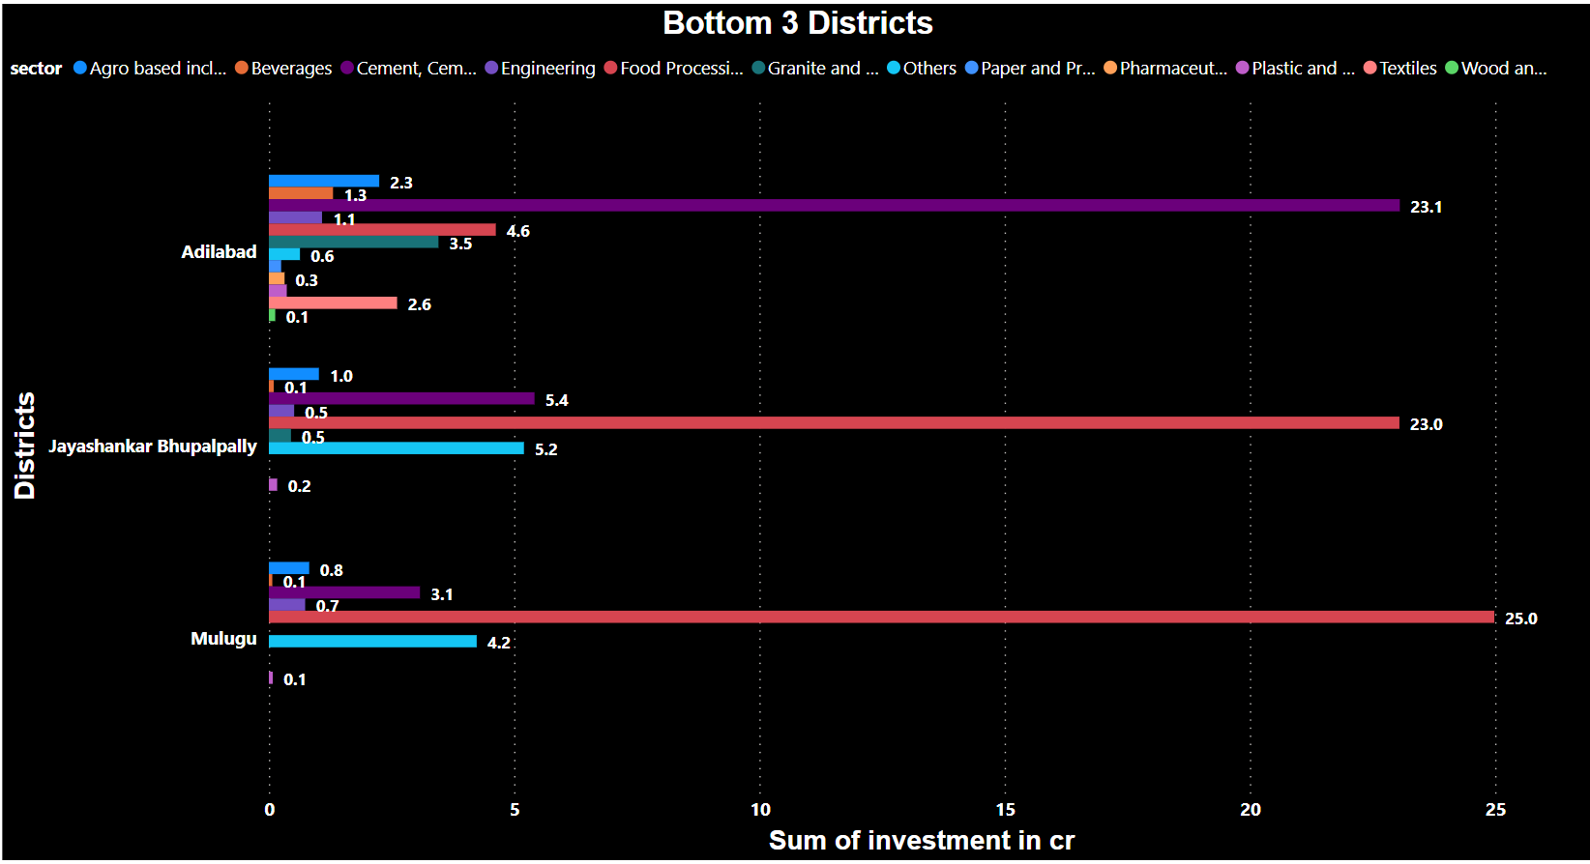
Agricultural vehicles are sold less then compared to other type vehicles. Initiatives should be taken to improve the agricultural production in the state.
The bottom 3 districts where investment is low.

Slide 36
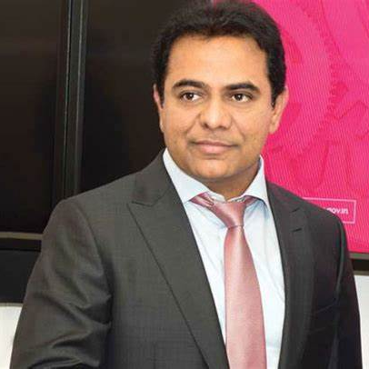
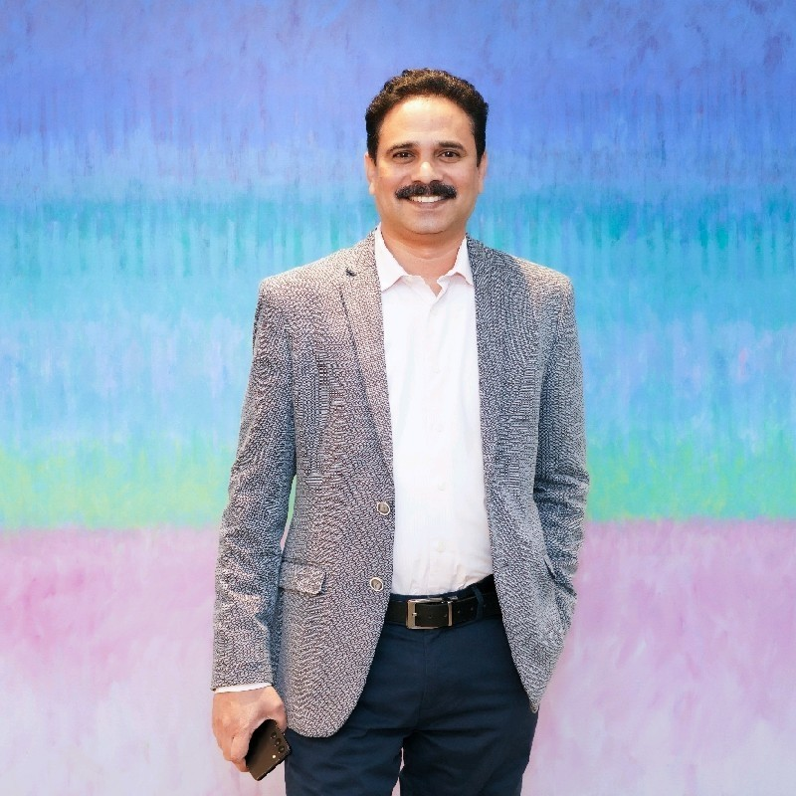
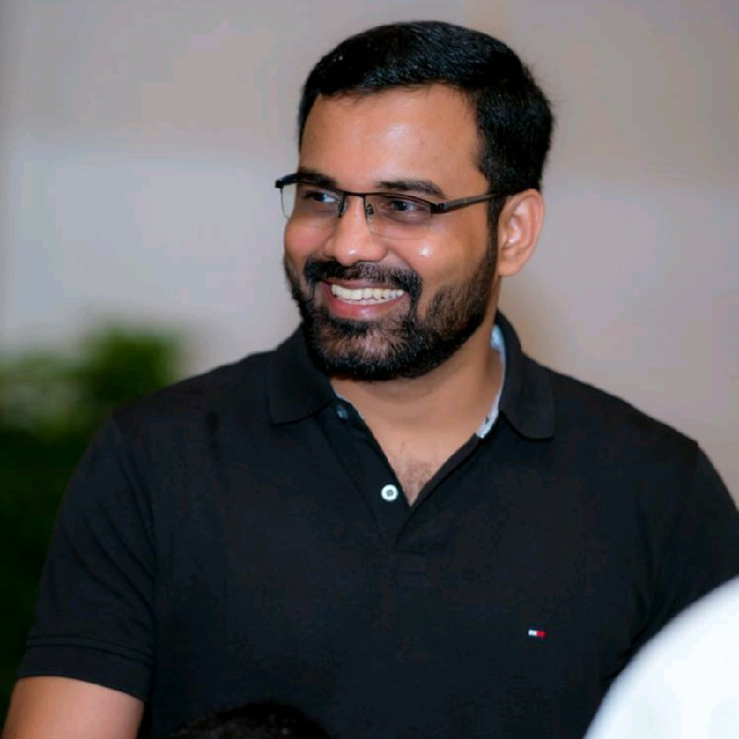
Stake holder
Kalvakuntla taraka ramarao
Dileep konatham
Venu panjarla
Minister of IT industries and Municipal Administration
Director at Government of Telangana
Open Data Telangana

Slide 37


Stake holder
Dhaval patel
Hemanand Vadivel
Founder , Codebasics
Co-Founder , Codebasics

Slide 38
THANK YOU
Kamutam Litheeshwar
litheeshwar.ramesh@gmail.com
https://www.linkedin.com/in/kamutam-litheeshwar-7841a523b/

